Slide 1
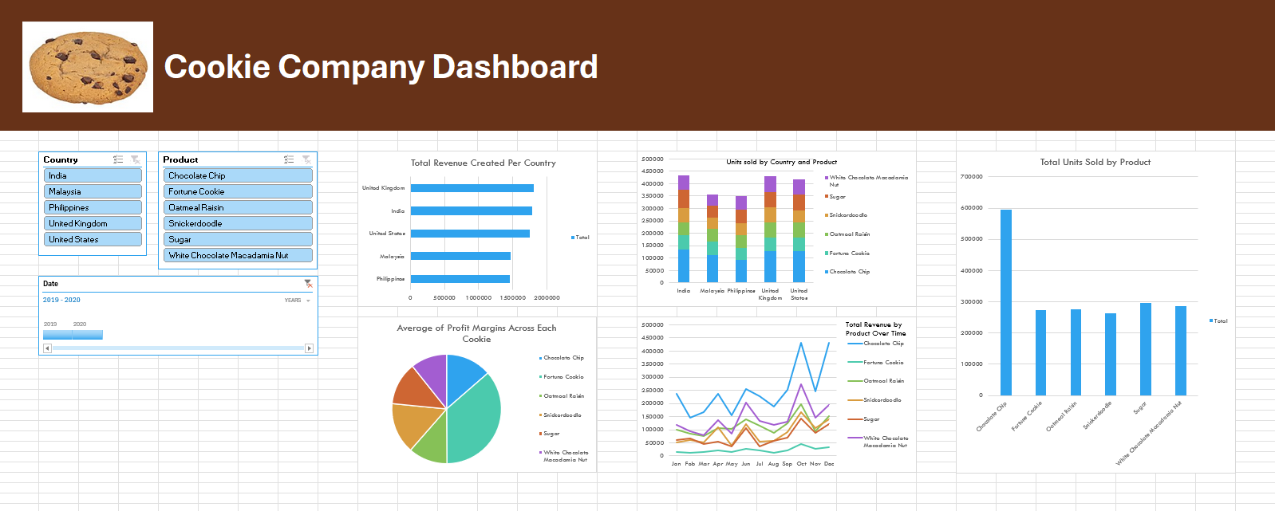
Excel Portfolio Project
An Overview into the process

Slide 2
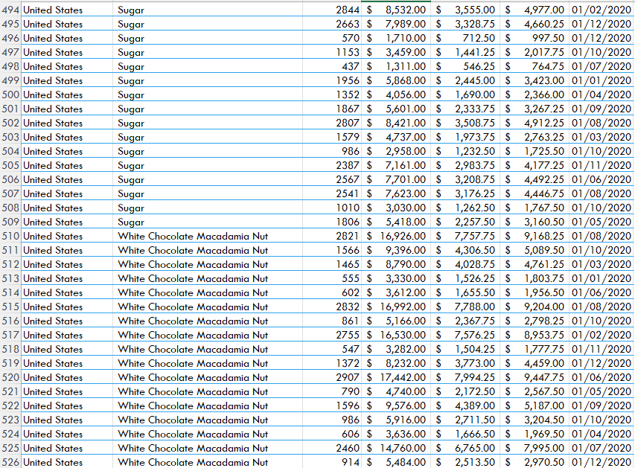
Project Aims
Excel is an important tool for preparing and analysing data so information and insights can be gathered from it, telling us about how a business is managing, and what they can do to improve their level of success.
My aim was to transform a set of raw data about the sales of a cookie business and gather important insights about how the business was performing over time, utilising various tools such as the ability to make pivot tables and graphs to streamline my data into digestible information.
Hundreds of rows?! Not an issue!

Slide 3
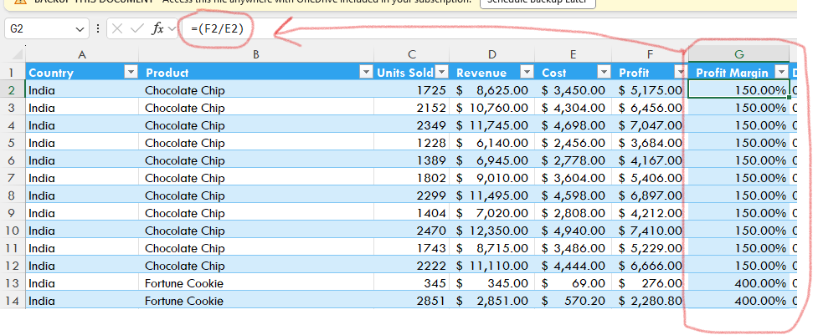
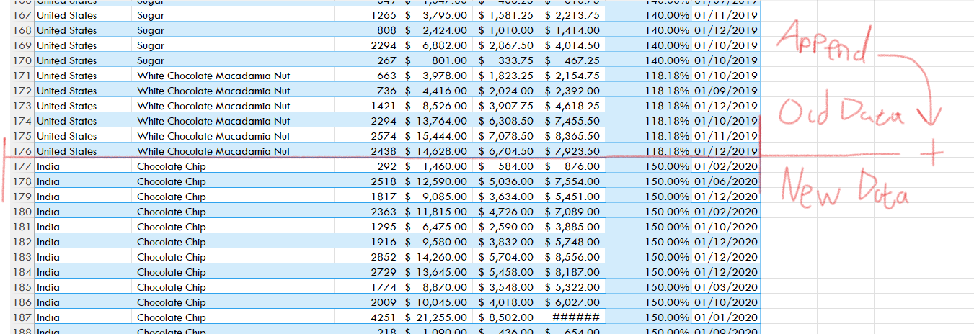
Cleaning my data
I had two sets of raw data, one for 2019 and another for 2020, and both needed some additions to get the information I want out of it. For instance, I could create a column on both to calculate the profit margin with through using a custom formula. Since both sets of data had the same columns I could convert one of the sets into a table and append the other onto it to create a single stack of data for all my analysis needs.

Slide 4
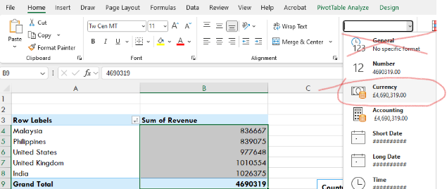
Pivot Tables
With this table I could begin to make pivot tables, where I could choose what values I could choose from to get a much easier to digest overview on certain areas, such as the total revenue. It is also important to set the value types correctly since these types (such as currency and percentage) are carried over to any graphs I create.

Slide 5
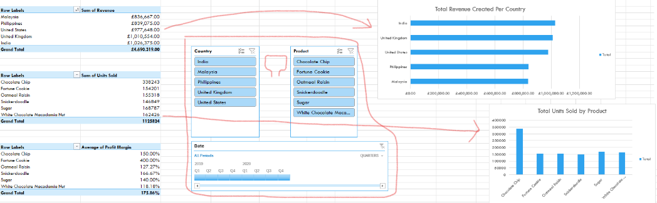

Slicer Integration
Slicers are also important for more focused perspectives into performance, as I could use these to look at the performance of a single product type, performance over a set time span, or both at the same time. I used these both within the sheets where I was preparing the data and in the dashboard itself.

Slide 6
Finished Dashboard
Transferring the graphs and slicers to the dashboard sheet was easy, and results in a far more digestible suite of information that could be the grassroots of informed business decisions in a real scenario. With all the components complete, detailed analyses can begin!

Slide 7
Key Insights:
Transferring the graphs and slicers to the dashboard sheet was easy, and results in a far more digestible suite of information that could be the grassroots of informed business decisions in a real scenario. With all the components complete, detailed analyses can begin!
All sales see a notable uptick in October and December, though November sees them drop sharply. We could see what marketing campaigns we are using for Halloween and the Holiday season – perhaps our investment in them is what is driving up sales?
The United Kingdom alone accounts for the second highest quantity of all units sold. As the country is the only one in West Europe we sell to at the moment, there could be a lot of success to be found in expanding the brand into the mainland, provided we’re able to handle the production requirements.
Fortune Cookies are by far the least popular and profitable product in all locations, despite the extremely steep profit margin we sell at (400%). We could either reduce the profit margin and analyse the results over a short period of time or phase out this product in search of a more profitable one to take its place.

Slide 8
What to do differently
If I were to do this task again, I would also see about creating some KPI (Key Performance Indicator) contents into the dashboard for values such as the total profit made and the total units sold worldwide as a way to highlight these key areas immediately and effectively.

